Slide 1



Introduction to the Viva Learning extensibility How to leverage the connectors to transform customers’ learning culture
Divyanka Malik
Product Manager, Microsoft Viva Learning
Geeta Ramakrishnan
Sr. Product Marketing Manager, Microsoft Viva

Slide 2

Agenda
Viva Learning overview
How, What & When: Graph APIs
Get Started
Resources

Slide 3


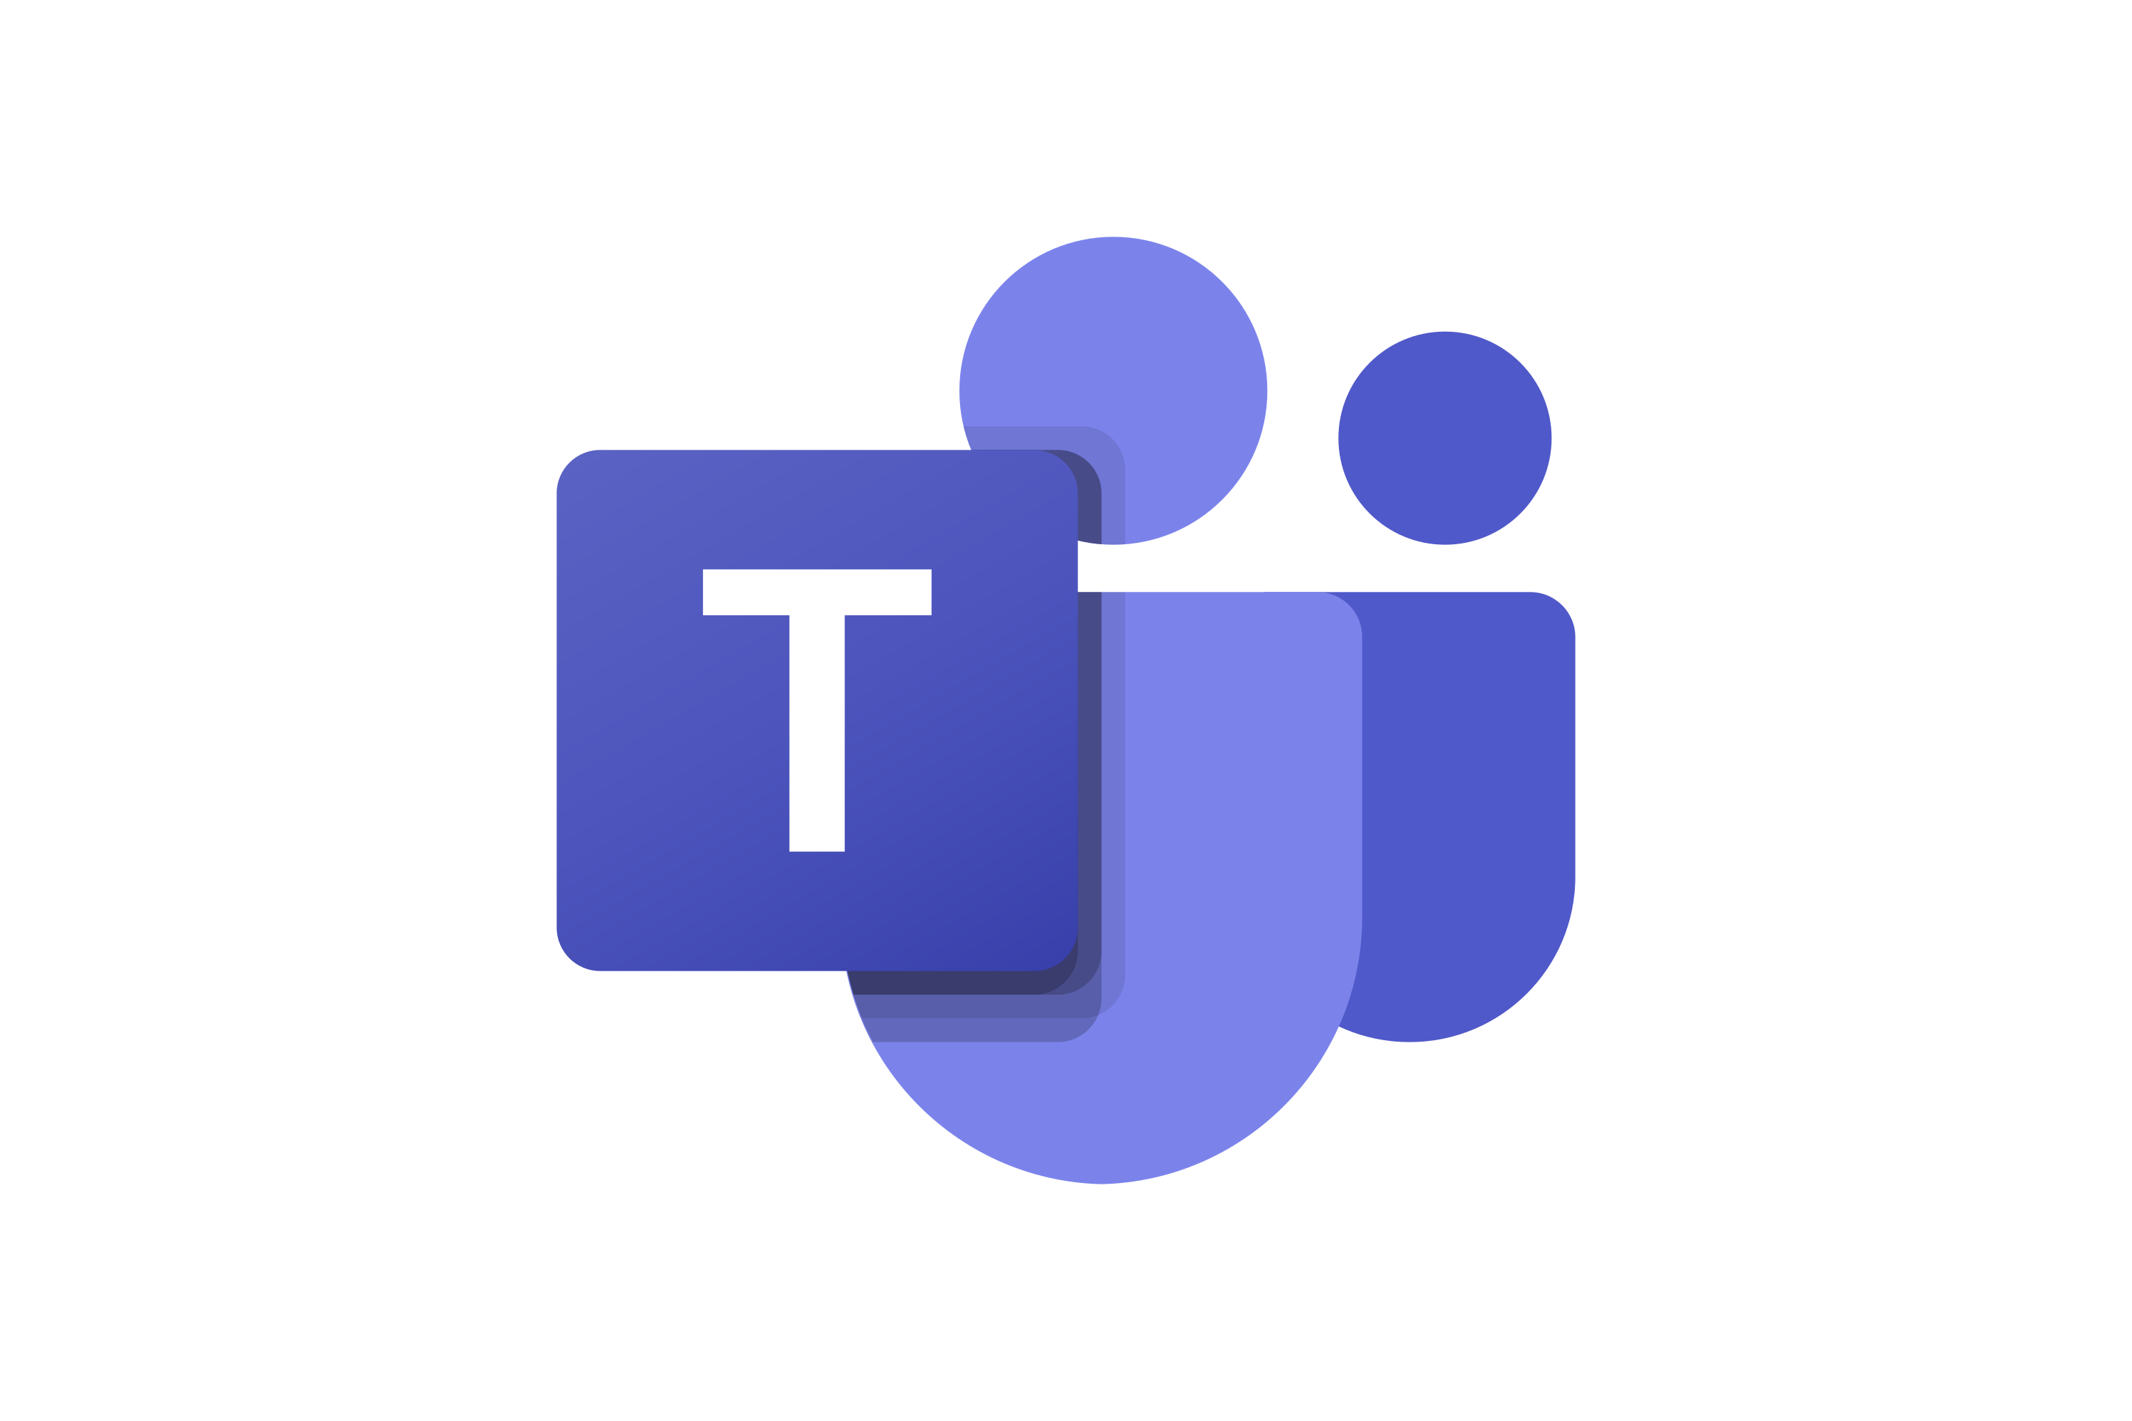


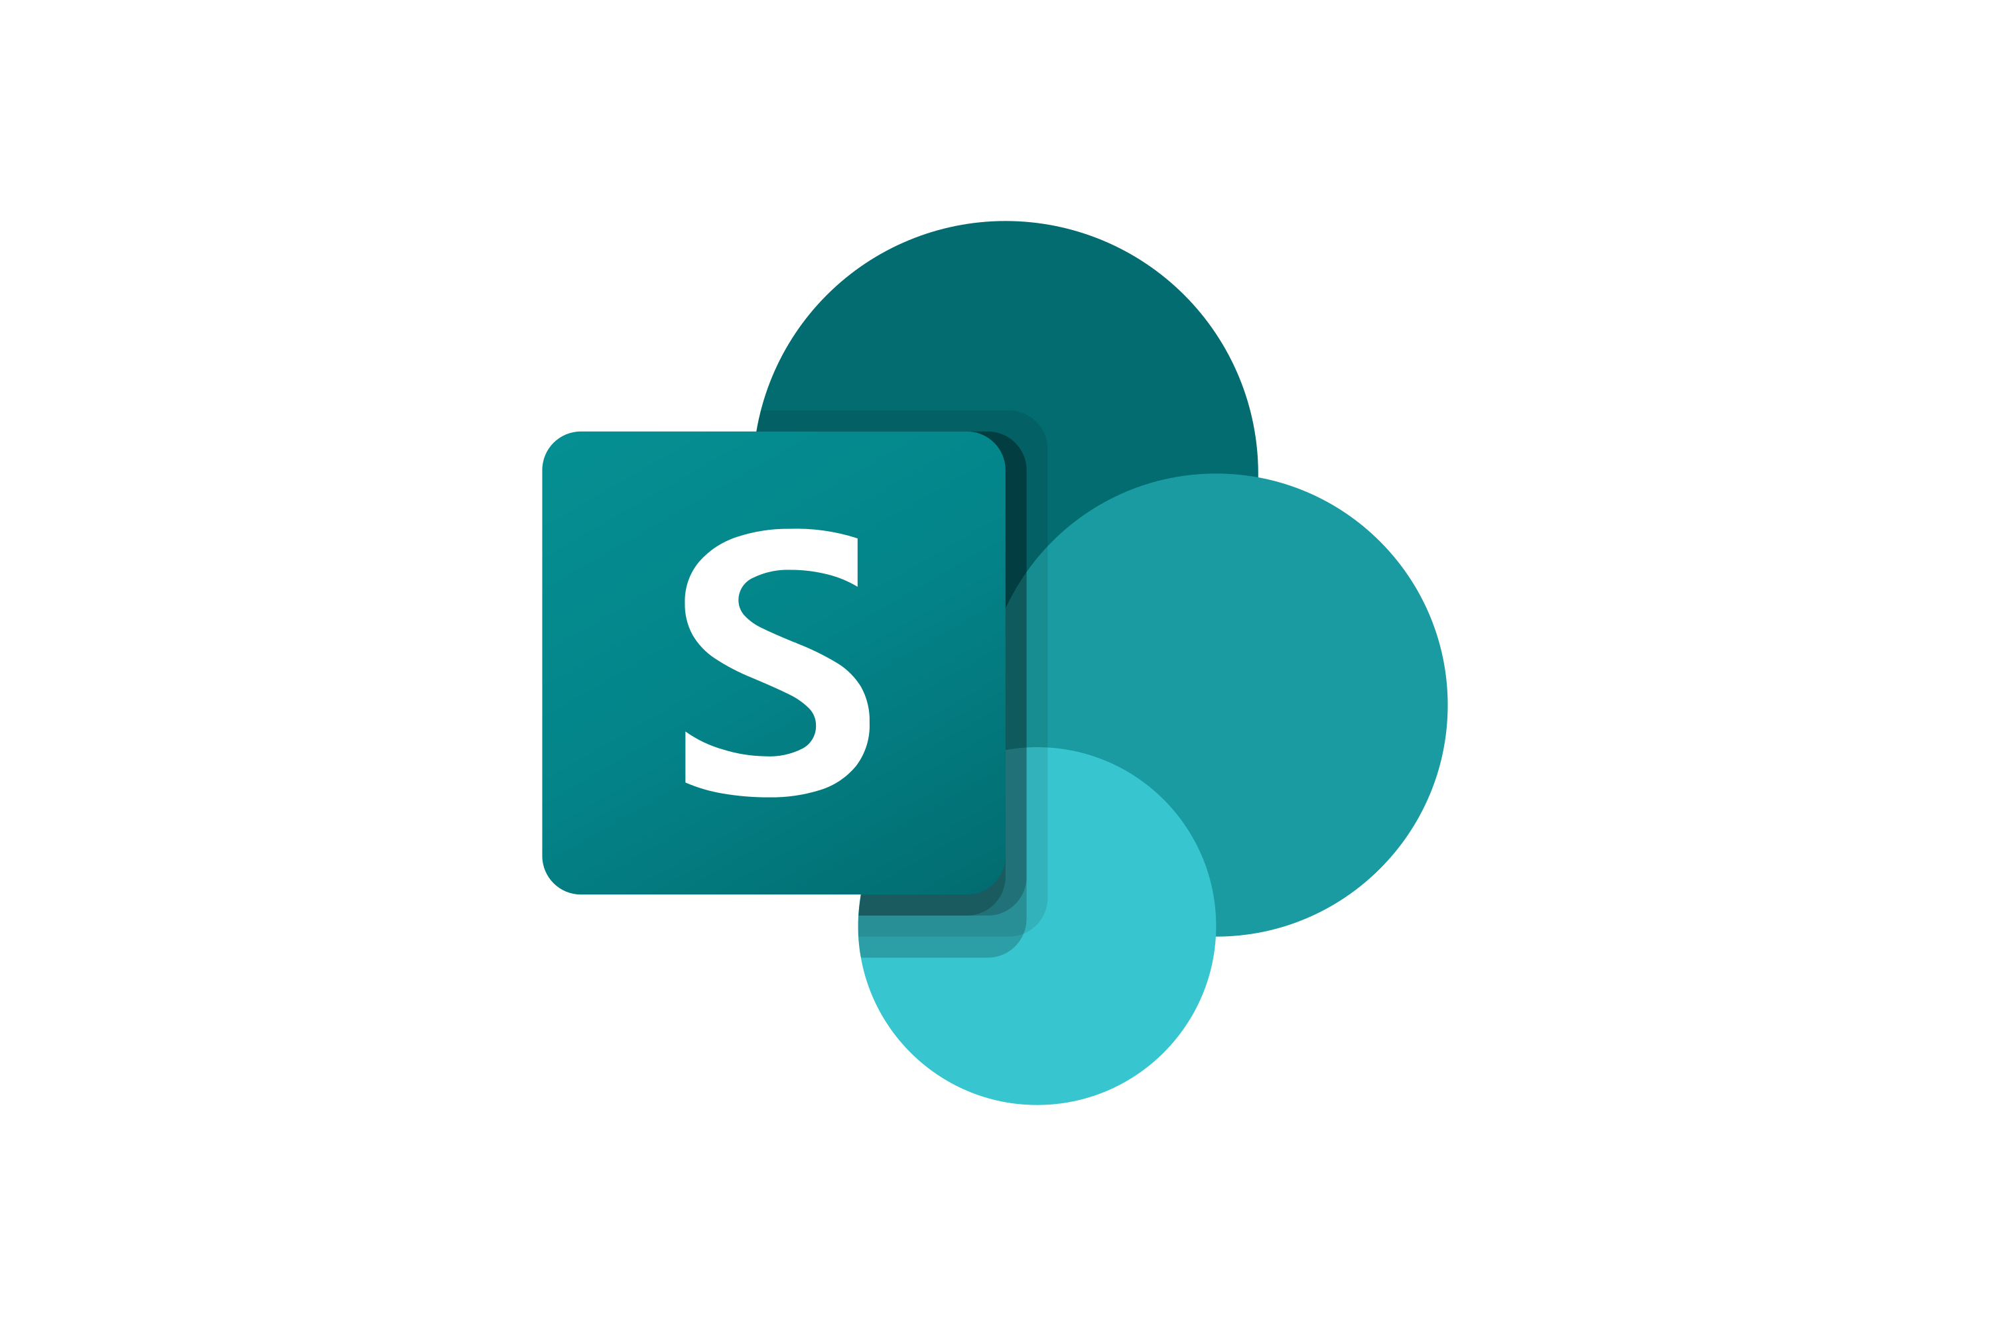
The current learning landscape
Learning experience separated from everyday work surfaces
LEARNING SYSTEMS
WORK SYSTEMS
Learning Content Providers
Learning Experience Platforms
Learning Management Systems
Chat, meetings,
and collaboration
Email and
calendar
Enterprise
search
Files and
intranet
Provide the actual learning content and courses
Front-end platform for learning content discovery, engagement, and personalization
Deliver learning programs and assignments and management of learner records
Notes:
To understand Viva Learning and why this product is so different from others in the market, we have to take a look at the current learning landscape. There are several categories of learning solutions and platforms that have dominated the learning market.
Learning content providers are the source for actual learning content and courses. There are several large players in this category, like LinkedIn Learning, Coursera, Pluralsight, and Skillsoft. The market for content providers is saturated, with many large players, in addition to niche providers that focus on certain topics, industries, and roles.
Learning Management Systems, or LMS, are typically admin and management tools used to track compliance & training progress and to get insights on overall learning adoption within the organization. These also provide a platform to deliver learning content to employees, by aggregating content from multiple content providers, and delivering that content to employees through course assignments and learning paths. Big names include SAP, Workday, and Cornerstone. This is leverages a “push” model for enterprise learning. Most companies with an LMS as their core learning system find most of their employees simply consume mandatory trainings, and otherwise do not take advantage of other learning resources or opportunities.
Learning experience platforms, or LXP, tend to be more end user-facing. The LXPs provide recommendations to end users on different courses & skills they should learn based on what they have already discovered, consumed & the skills they are trying to learn.
is a newer category of learning solutions. At a basic level, they provide similar functionality to an LMS, but differ in how the learner interacts with the platform. Where an LMS typically operates from a "push" model (i.e., content is assigned to learners), LXP solutions are more oriented to a curation-based "pull" model. Learners provide their career goals and learning interests, and the platform provides recommendations and connects learners to internally or externally hosted content. This is a newer category, and growing rapidly in the market – think Degreed and Edcast.
*click for animation*
So, there is A host of different solutions out there in the market but they often suffer pretty low engagement levels, engagement mark is below 10% outside mandatory trainings consumption. This happens because employees have to navigate through these trainings outside of their typical work surfaces. Meaning, employees will have to consciously decide to step outside of their email, file, and collaboration spaces where they’re doing their daily work, and launch their LMS or LXP separately to focus on learning. They don't find time & ease of access to integrate learning through out their day-to-day work experiences and that's why we see this low engagement among employees.
So, what if we had this new way of learning that inter-twined the experience of learning & personal development throughout the work surfaces that you are already working in.
As a result, LXPs and LMSes suffer low engagement, often showing single digit engagement percentages outside of mandatory training consumption – again, going back to the stat we saw earlier.
Organizations need to send a signal that they are invested in their employees’ growth and development, and through a fresh way that the industry hasn’t seen before. Times are changing, and the need for a modernized learning solution is high.

Slide 4
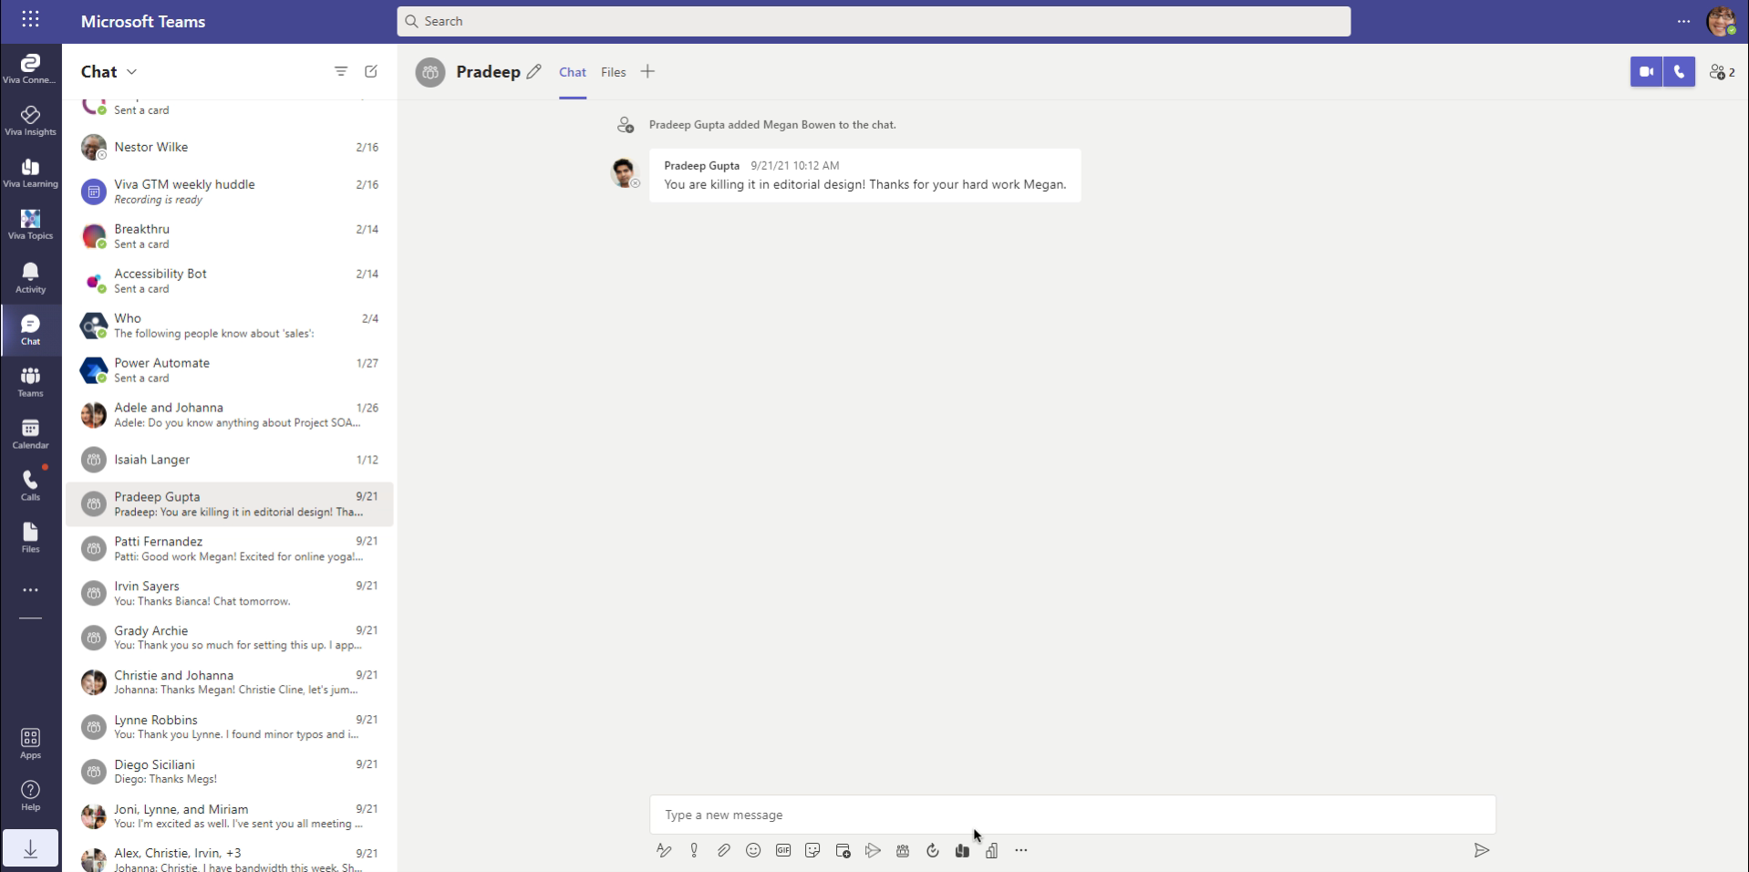


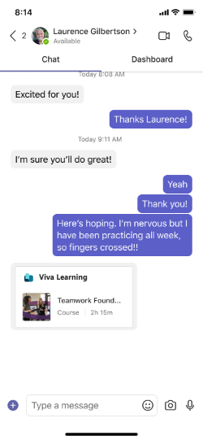
A new way of learning
Integrated learning experience across work surfaces
Share learnings
Learning assignments
Search for learning content
Learning recommendations
Browse learning content
Notes:
And that brings us to Viva Learning. Viva Learning is an in-the-flow learning solution for employees to discover, share, and consume learning content from libraries across your organization. This includes content from Microsoft and partner solutions, between learning content providers and Learning management systems, and even your organization’s own content. It is available on desktop, mobile, and tablet.
Viva Learning is built for Microsoft Teams and Microsoft 365. This means it is in the unique position to truly bring learning to where employees are working, like integrating into Teams chat and tabs, and throughout Microsoft and Bing search.
Your employees are already using Teams as a decentralized learning platform. In every meeting, every chat, every document collab – people are sharing information, gaining knowledge, learning new things, and growing. Viva Learning brings structured features, capabilities, and integrations with “formal learning” to supercharge the learning activities natively occurring in every Teams environment. With learning being an extension of the productivity platform, rather than a separate entity, it is easier for employees to prioritize their growth and development. And learning becomes inherently social, which data shows is the most effective way to learn.
Plus, for managers and organization leaders, it sends a signal to employees that they are prioritizing a culture of learning and growth, by placing it top of mind and making it easier to access learning investments that they have made.
Here on this slide is an animation showing the Viva Learning Teams chat composition feature. As you can see, you can send a learning course right from your chat composition box. No stepping out into a separate app to interact with learning – we’re bringing learning right to where you are.

Slide 5


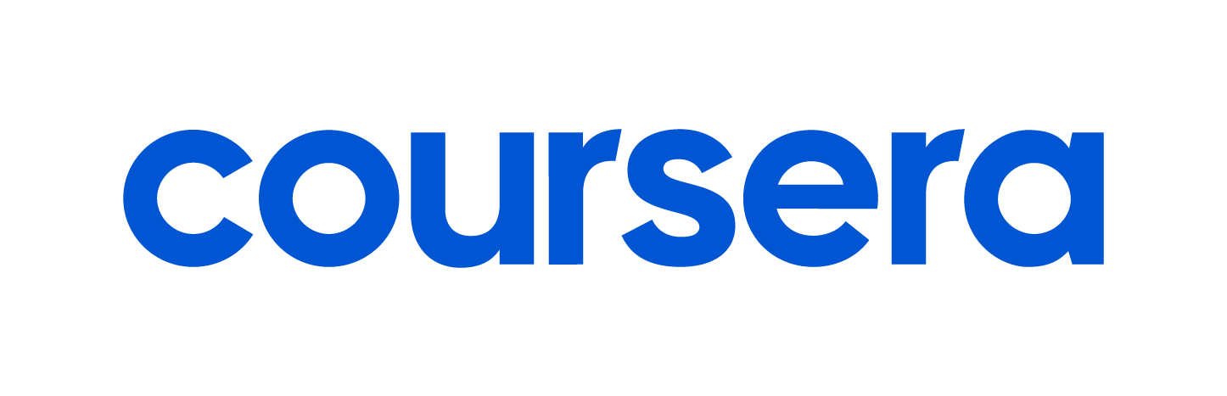

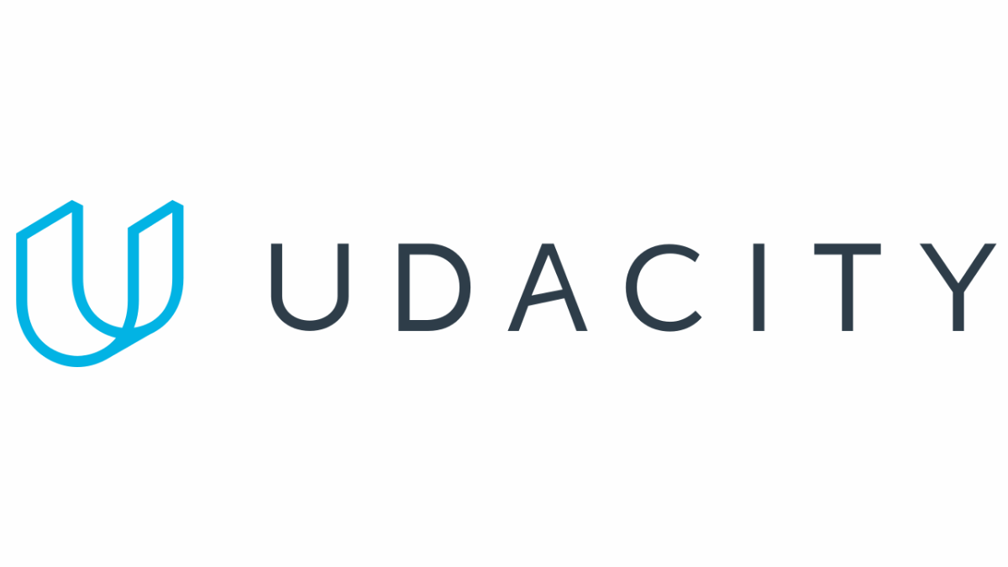







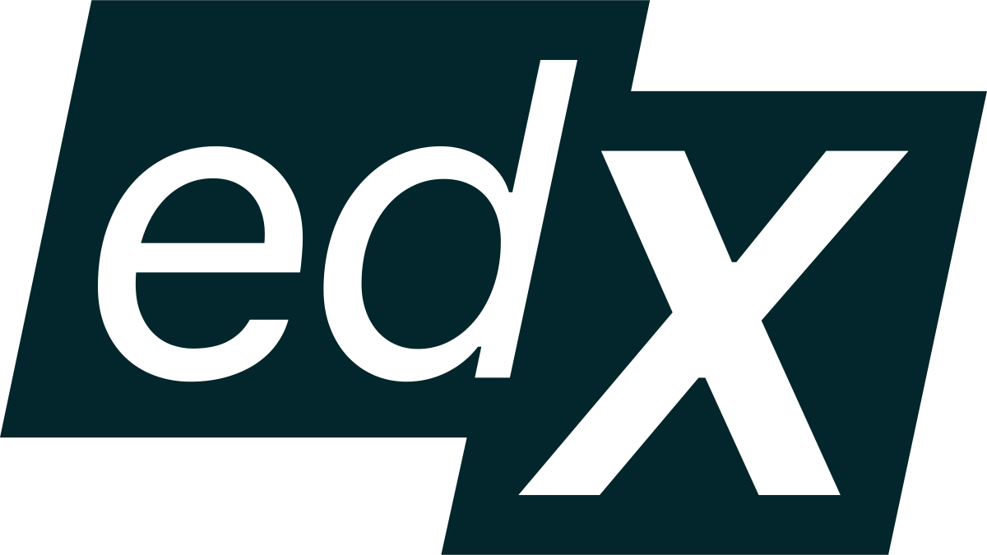



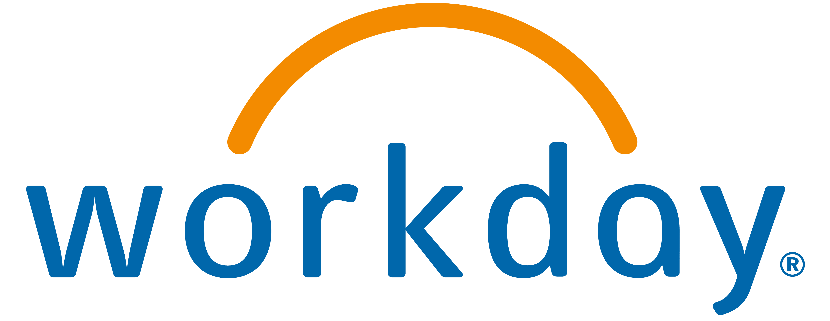
Viva Learning
Learning in the Flow of Work
Bring learning to the tools and platforms where users already spend their time
Simplified Learning
Aggregate learning content and tools from different sources in one central hub
Personalized and Relevant
Find the right content and develop new capabilities with personalized recommendations and search
Teams + Microsoft 365
Platform layer
API enabled partner integrations
Aggregation layer
Graph API: Content catalog
Graph API: LRS
NEW
Coming soon
Coming soon
Data layer
Microsoft Graph
Notes:
We’ve partnered with leading learning providers and learning management systems in the market to make Viva Learning a comprehensive and extensible learning platform. Providers like Pluralsight, Coursera, Go1 and the others on the slide offer breadth and depth of learning content spanning industries, roles, and subjects. And our three LMS partners, Cornerstone OnDemand, SAP SuccessFactors, and Saba Cloud bring advanced learning features to Viva Learning too, like assignments and learner records. We’re also integrating Workday as an LMS partner, and building Graph APIs which will allow you to connect any learning provider or learning management system to your Viva Learning tenant, even if they aren’t one of our pre-configured partners.
Underneath all of this is the Microsoft Graph. Like most Microsoft solutions, Viva Learning connects with your organization’s Azure Active Directory so users can connect with colleagues and workgroups throughout their learning experience. As we continue to build deeper personalization features, Viva Learning will also become more intelligent, providing system-generated learning recommendations based on your work activity, network, role, and more.

Slide 6

How, What & When: Graph APIs
Divyanka Malik

Slide 7
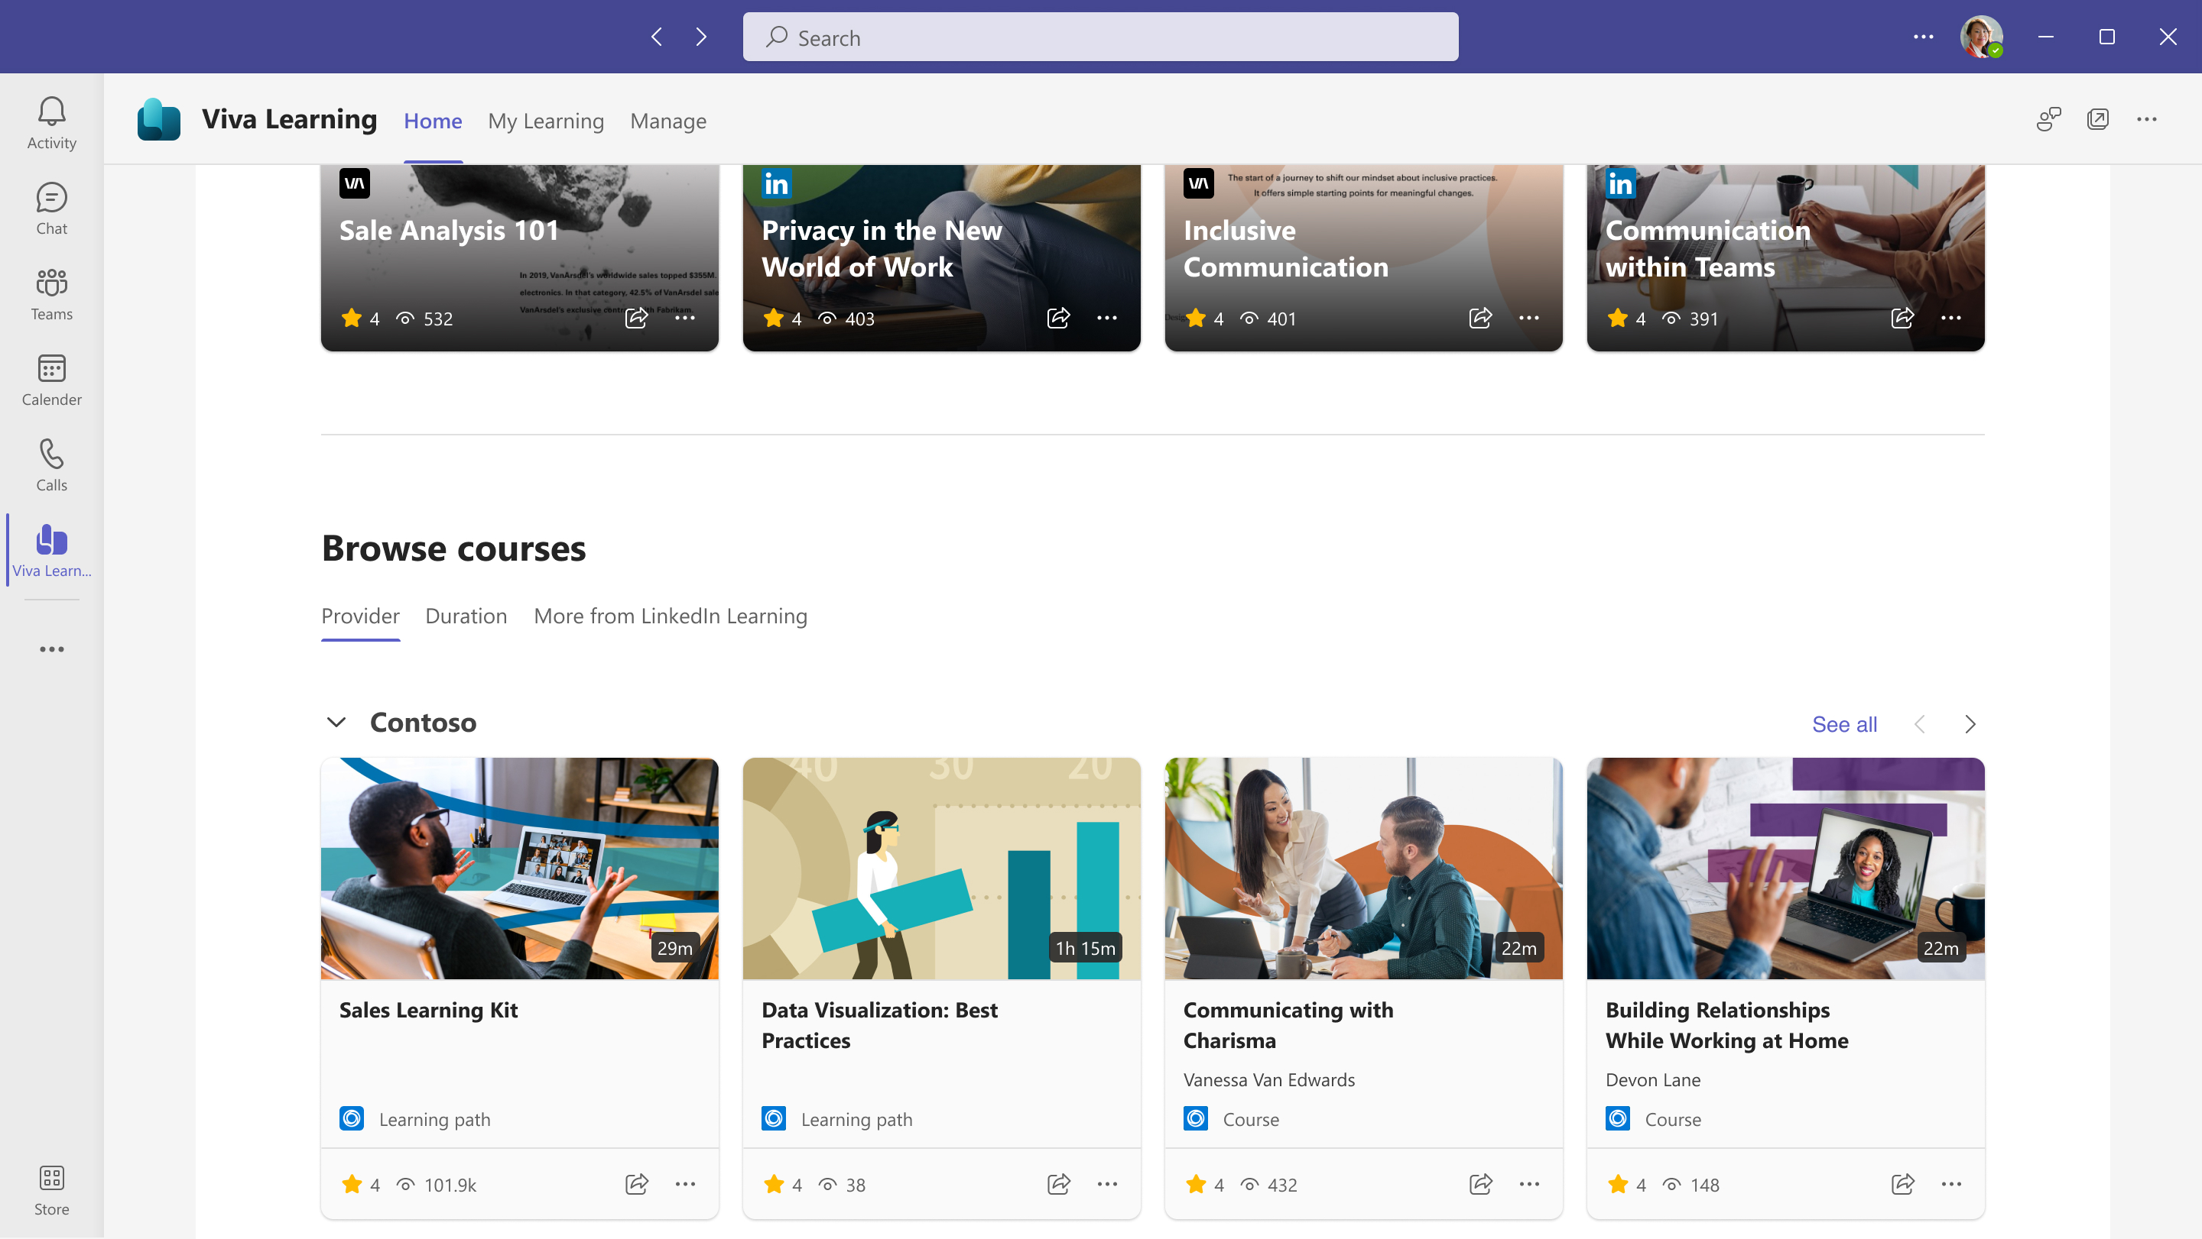
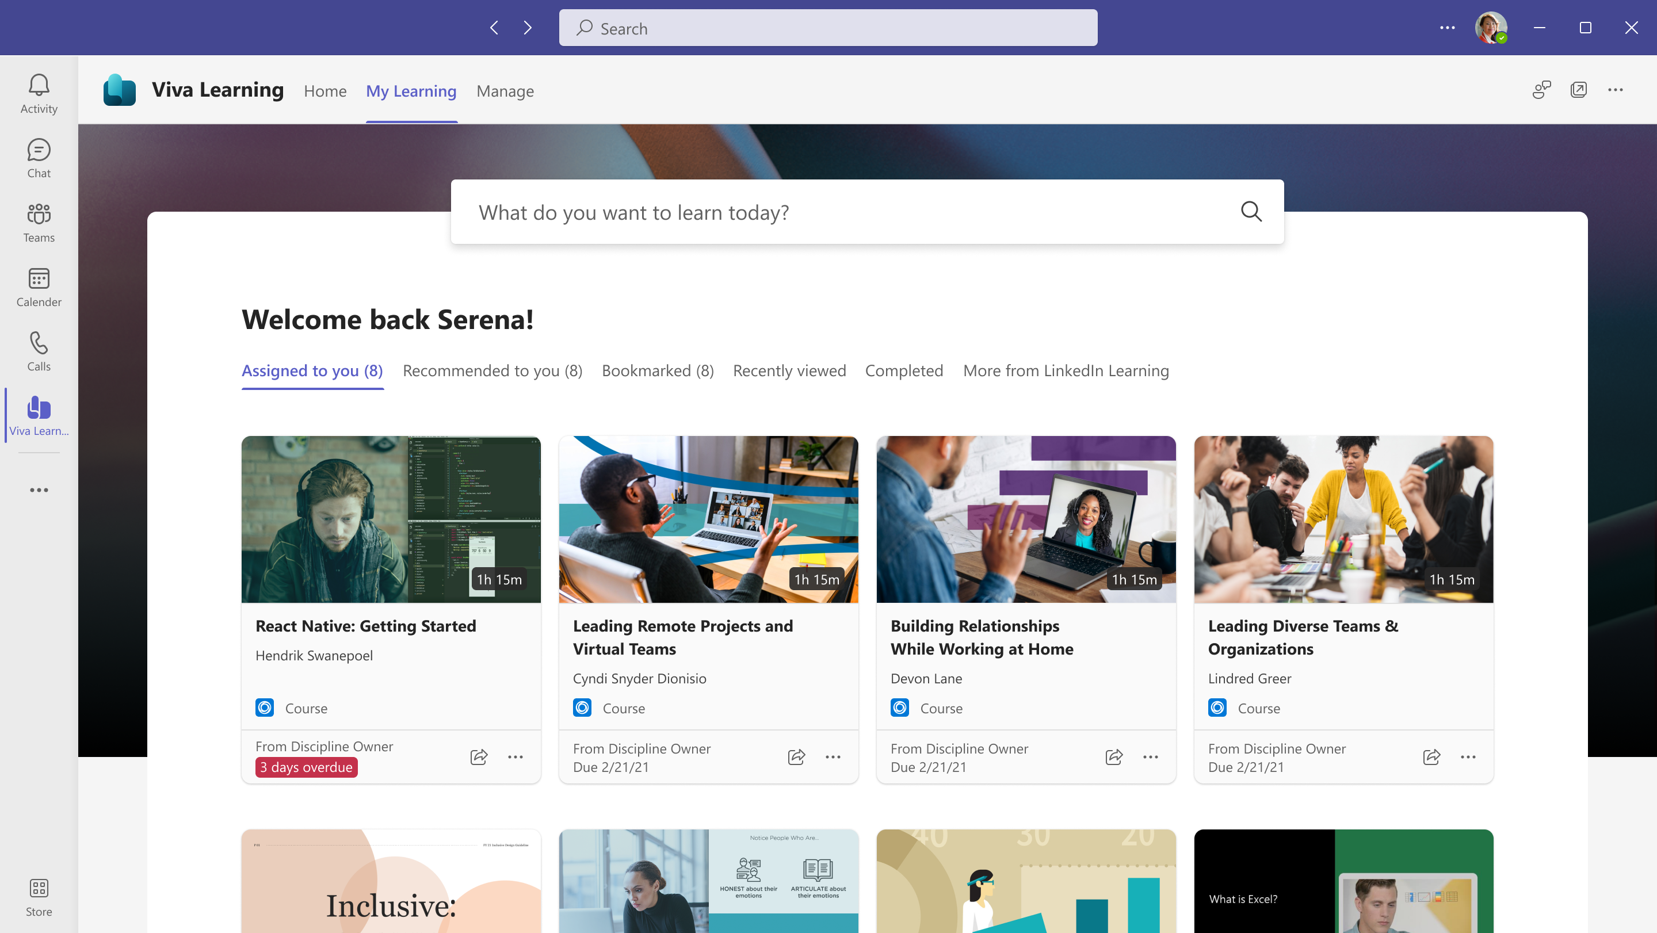
Understand Learning sources integration- Diagram LMS Learning content and assignments
Use cases
Content Catalog Sync – Users can discover the content from their LMS within Viva Learning & consume the content in LMS.
Learner Record Sync – Users can discover their Assigned & Completed courses from LMS within Viva Learning.
Viva Learning
Out of Box Integrations
LMS/3P sources
Data Sync
Processor
Fetcher
Pull
Content catalog
Customer’s learning content catalog
Graph APIs
Assignments & Completion
records
Data Sync
Content sync APIs
Push
Assignment & Completion sync APIs
Learner's Assignments & Completed courses
Connectors
Notes:
Starting with the How – How the Learning sources integration work today in Viva Learning through OOB integrations & Graph APIs. This diagram helps explain the same.
There are 2 use cases that we are supporting – a. Content catalog sync – Users can discover the content from their LMS/ 3P sources within Viva Learning & consume the content within the provider platform. B. Learner Record sync – Users can discover their Assigned as well as completed trainings from their learning provider within Viva Learning.
Now, let’s look at how these integrations work through this diagram – Starting from the right side, we have LMS/ 3P sources with the learning content & assignment & completion records. These records are pulled into Viva Learning using the OOB integration connector – The records are fetched by the fetchr post which the data is processed and synced into the Viva Learning data store from where this data is surfaced within Viva Learning. Now, using the Graph APIs, these content & learner records can be pushed into the Viva Learning using the content sync & Assignment & completion sync APIs available, post which these records will be synced into the Viva Learning data store & then surfaced within Viva Learning. As you can see on the left hand side the learning content & learner’s assignments & completed courses are surfaced within Viva Learning.
Take a pause after covering the slide for questions.

Slide 8



Viva Learning Graph APIs
Content Sync API
Assignment sync API
Completion sync API
Scenarios
Scenarios
Scenarios
Provider Registration Register the learning provider. You can enable/disable and update the provider. Use the registration id for content ingestion. Ingest Ingest the learning content with metadata. Update Update the ingested learning content. Delete Delete the ingested learning content. Get Read the ingested learning content.
Ingest assignment record Ingest the assignment record for the learner & learning content. Update Update the ingested assignment record. Delete Delete the ingested assignment record. Retrieve Read the ingested assignment record. Retrieve all assignments for a learner Retrieve all assignments for a learner for a learning content
Ingest Ingest the completion record for the learner & learning content. Update Update the ingested completion record. Delete Delete the ingested completion record. Retrieve Read the ingested completion record. Retrieve all completion records for a learner
Notes:
Now that we have covered the How, let’s look at the different APIs supported in Viva Learning along with the scenarios for each. Starting with the content sync APIs – These APIs allow you to sync in content for a tenant within Viva Learning. The scenarios supported are – Provider registration to register the provider, you can also enable/ disable & update the registered provider. You can use the provider registration id for content ingestion. The other scenarios supported are CRUD operations for the content, so you can ingest the learning content & update/ delete & retrieve the ingested learning content.
Moving on to the Assignment sync APIs. These APIs help sync in the learner’s assignments within Viva Learning. The scenarios supported are – You can ingest the assignment record for the learner & the learning content. And also update/ delete/ retrieve the ingested assignment record. You can also retrieve all the assignments for a learner & retrieve all the assignments for a learner for a learning content.
Next we have completion sync APIs. These APIs help sync in the learner’s completed trainings within Viva Learning. The scenarios supported are – You can ingest the completion record for the learner & the learning content. And also update/ delete/ retrieve the ingested completion record. You can also retrieve all the completion records for a learner.

Slide 9
Learning content in Viva Learning
Notes:
Now let’s look at how the content will be visible within Viva Learning post the ingestion. The content will appear in the Home page, in the Browse courses section under the Providers tab. The courses will appear under the carousel, you can choose the display name under which you want the courses to appear.

Slide 10
Learner Assignments in Viva Learning
Notes:
The Assignments will appear under Assigned to you section in the My Learning tab.

Slide 11
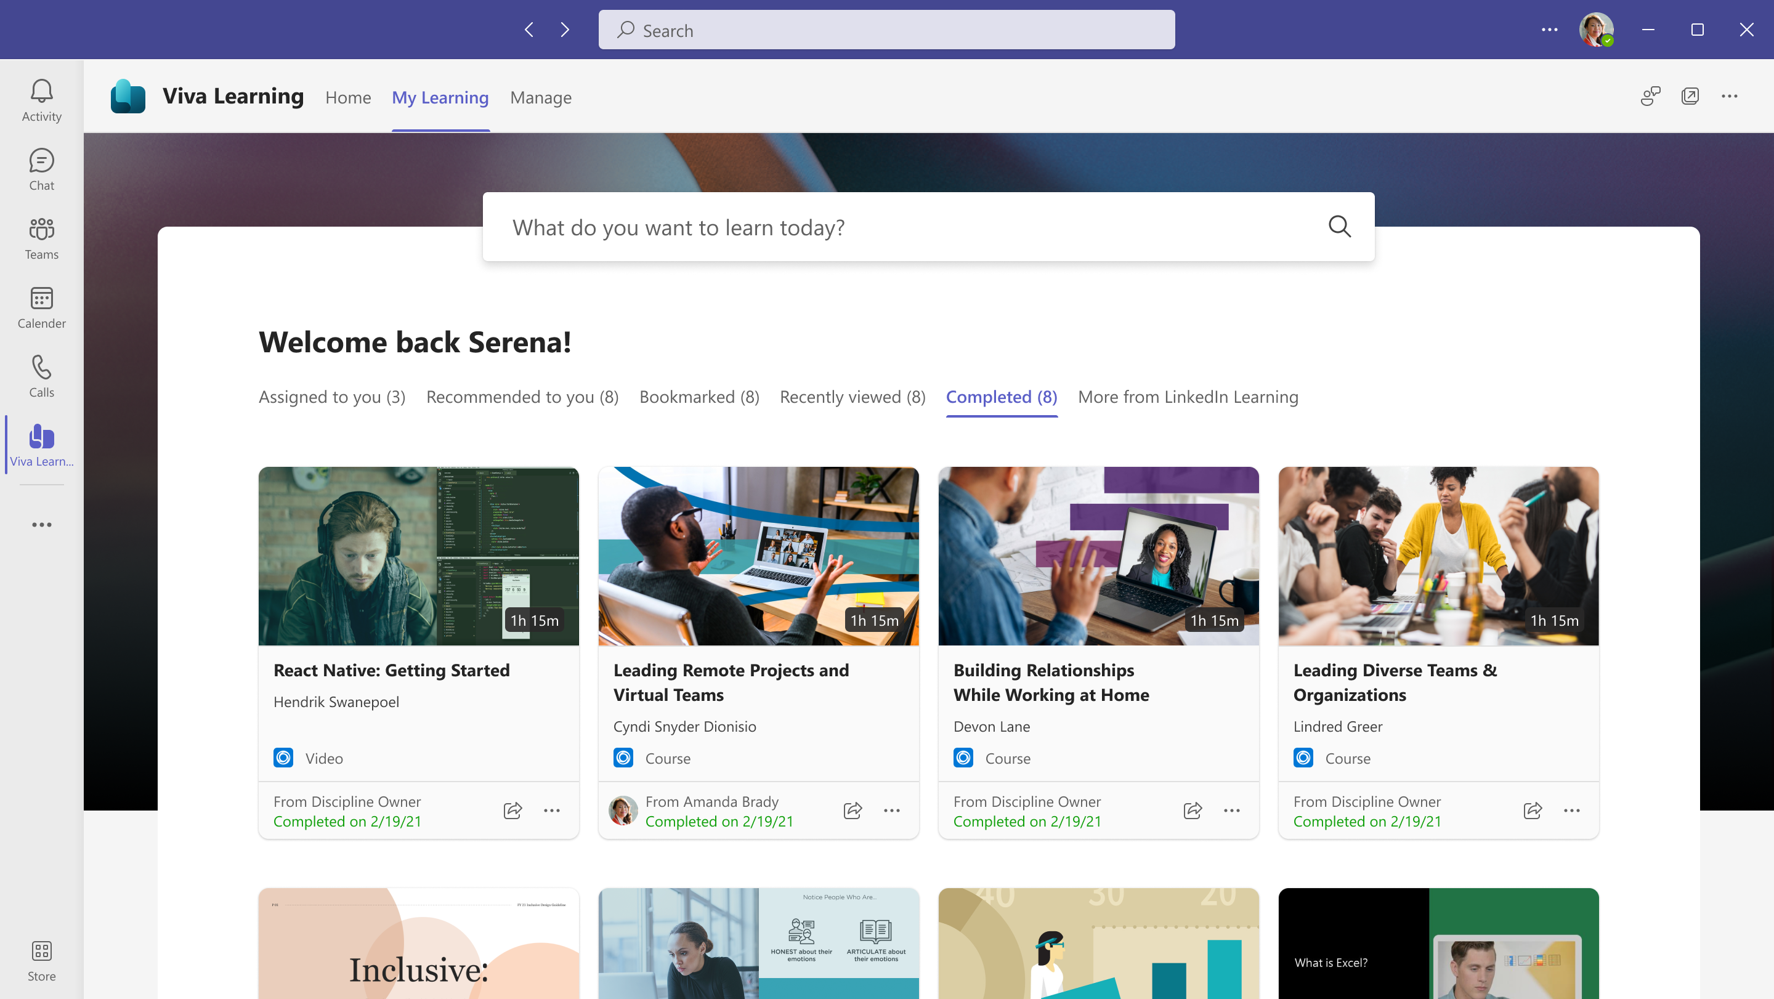
Learner completed courses in Viva Learning
Notes:
The completed courses will appear under the Completed section in the My Learning tab .

Slide 12

Announcing: Content Sync Graph APIs
Now in Public Preview

Slide 13




Viva Learning Graph APIs
Now in Public Preview
Content sync APIs
Discover courses from any platform within Viva Learning
Private preview: complete
Public preview: now available
GA: coming soon
Learner record sync APIs
Discover assigned & completed trainings from any platform within Viva Learning
Preview: coming later
Notes:
This is where we see the largest partner opportunity, at least on the technical side, to set up these APIs so customers have a custom learning solution that includes all of their preexisting learning investments.

Slide 14
Get started with Viva Learning Graph APIs
CTA: follow instructions on the public documentation for Graph APIs to start connecting your or your customers’ LMS/learning providers to Viva Learning
^{Aka.ms/VLGraphAPIdocumentation}
Notes:
New section for Graph API in documentation
Using on-call bandwidth for support for Graph APIs – check w/ Dee
Can set up in 15 minutes
Make aka link

Slide 15


Resources and next steps
Learn more about Viva Learning
General product info:
Webpage: aka.ms/VivaLearning
GA blog: aka.ms/VivaLearningGA
Adoption page: aka.ms/VivaLearningAdoption
Deep dive:
Documentation: aka.ms/VivaLearningDocs
Graph API: Aka.ms/VLGraphAPIdocumentation
Partner Practices page: aka.ms/Viva/Learning/PracticePage
Notes:
_________________________________________
Source: Microsoft Work Trend Index Annual Report 2021

Slide 16

Thank you.

